Slide 1
Hackerdew
By Chen Tsung Yu (Lear), Kho Nyak Lek (Eric), Kuo Kuan Ting (Mimi), Xu Tianxiao (Albert), Ho Chieh Yu (Jasmine)

Slide 2

Smart Campus with AI

Slide 3
“There’s no such thing as a stupid question”
Notes:
* In the very first class of every semester, most professors will say something like There’s no such thing as a stupid question/don’t be afraid to ask question!

Slide 4

Notes:
In reality, many of us may be still too shy to ask/do not want to interrupt the lecture
As a result,

Slide 5

Our goal
Enhance student learning experience with an “effortless” interaction between students and the professor
https://goo.gl/images/wbd9BR

Slide 6

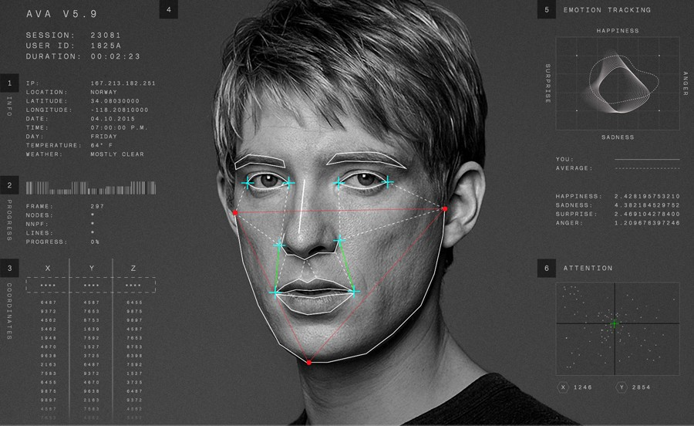
Idea
KatchUp
Source: https://thefwa.com/cases/ava-sessions-t64

Slide 7
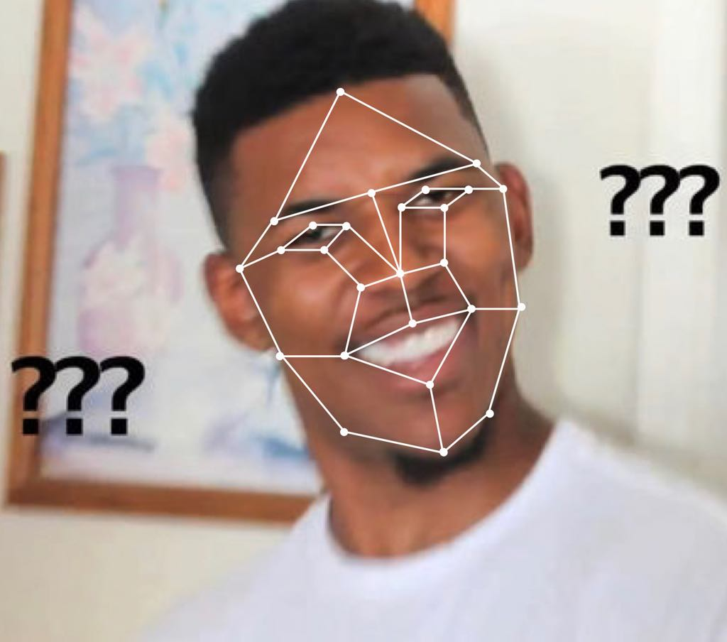
Face Recognition
Application of neural network
Able to identify 6 situations
Understood/Confused
Exclude: Dozing off/Doing Other things/Talking/Playing mobile phone

Slide 8
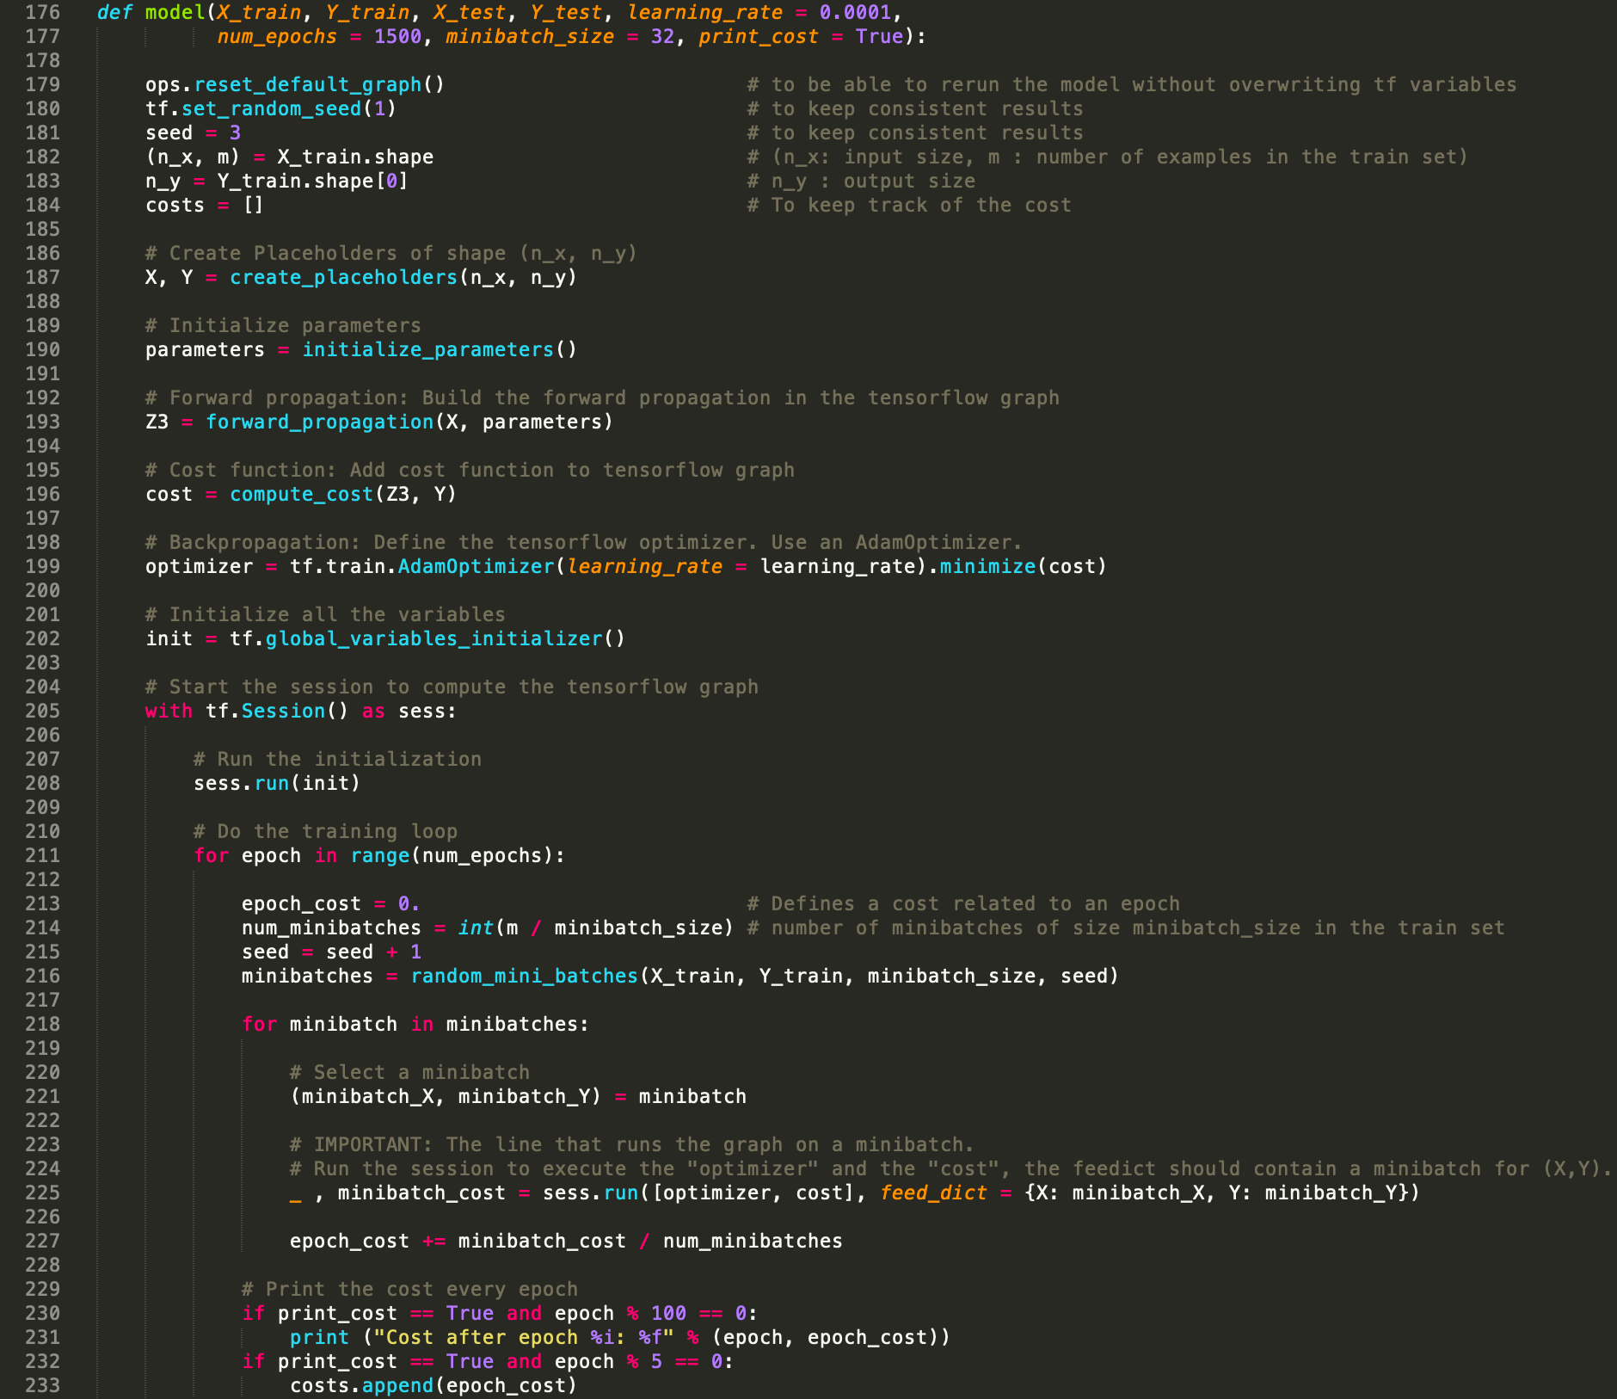

Slide 9
In practice
Scenario: Massive confusion detected
e.g. >30% students seem to be confused
Send out question set
Professor
Students
KatchUp
Feedback allows the professor to locate the confusing part

Slide 10
App Interface Display
KatchUp

Slide 11


Slide 12
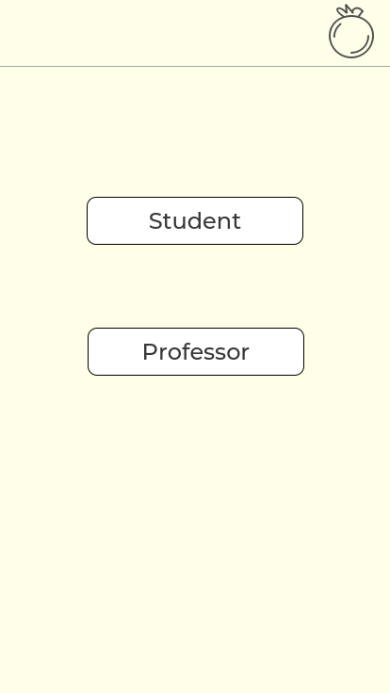

Slide 13
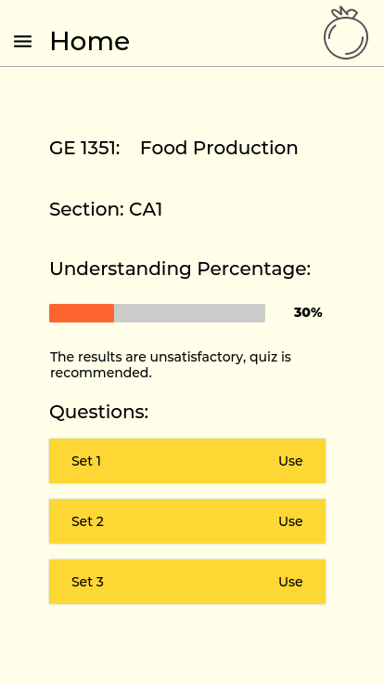

Slide 14
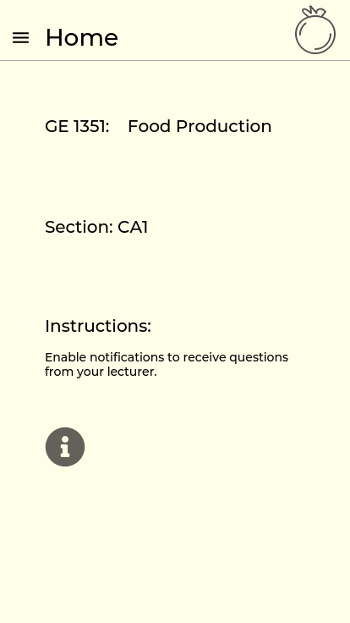

Slide 15
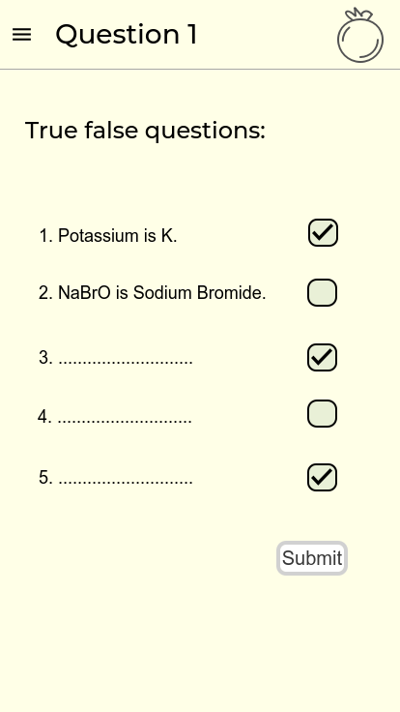

Slide 16
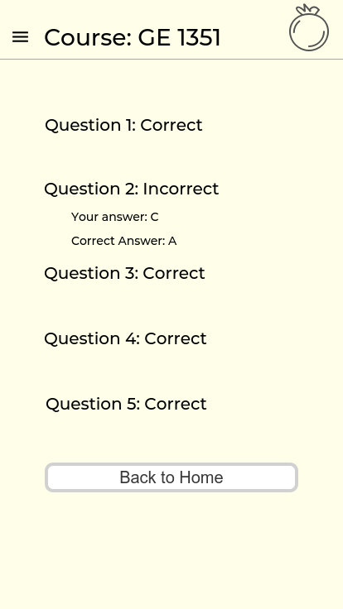

Slide 17
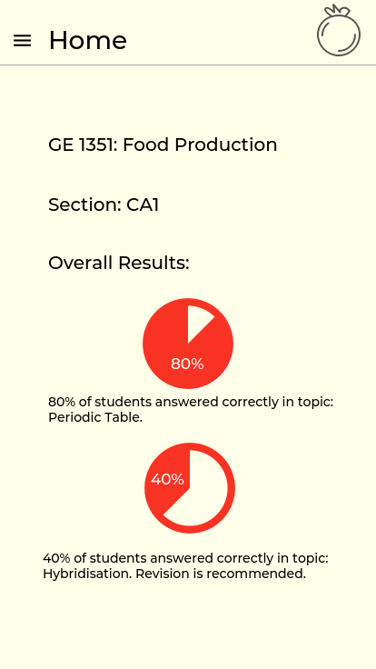

Slide 18
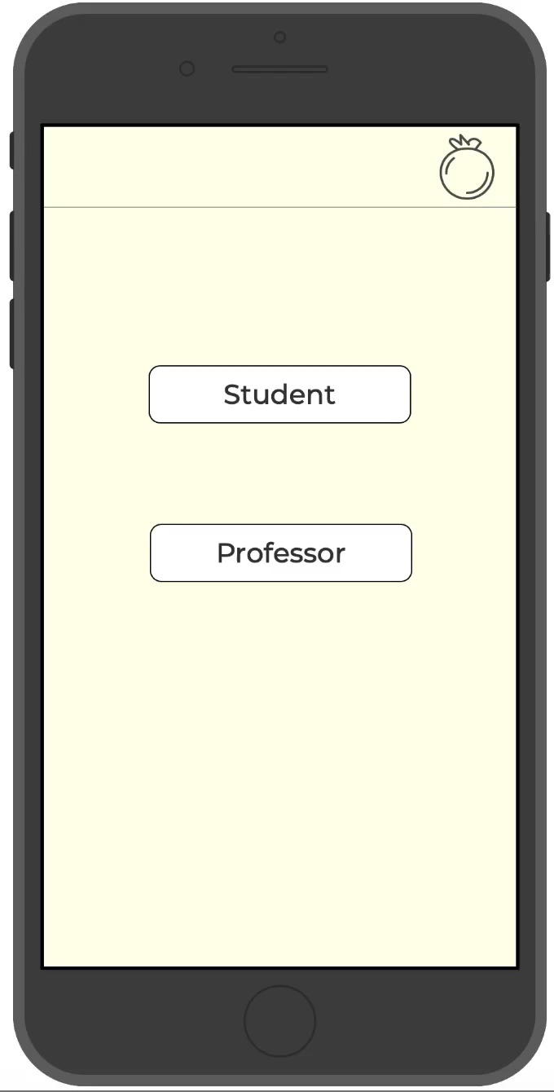

Slide 19
Thank you Q & A

